Slide 1
Science Everywhere
How science affects your life each day
Corey Peoples
Pack 455
NSC BSA

Slide 2
NOVA Award Steps
Learn for an hour
Earn an adventure for your rank
Act like a scientist
Visit where science is done
Discuss what you’ve learned

Slide 3
1. Learn for an Hour
Books
Turn it loose : the scientist in absolutely everybody
Science : a visual encyclopedia
What's going on? : collecting and recording your data
TV Shows
Mythbusters
Bill Nye the Science Guy
Planet Earth
NOVA
Magic School Bus
Movies
Walking With Dinosaurs
March of the Penguins
October Sky
The Right Stuff
Lorenzo’s Oil
Youtube
Sid the Science Kid
McSteigerScience
Ted Talks
Knowledge Channel

Slide 4
2. Group Activity – Rank Adventure
Wolf Cub Scouts | Bear Cub Scouts | WebelosScouts
Collections and Hobbies | A Bear Goes Fishing | Camper (B)
Digging in the Past | Bear Picnic | Earth Rocks!
Germs Alive | Critter Care | Maestro!
Grow Something

Slide 5
2. Group Activity – Scientific Method
Explain the steps of the Scientific Method
Use it in an experiment
Talk to a scientist about why they chose that career

Slide 6
2. Group Activity – Orienteering
Show how to orient a map
Find 3 landmarks on the map
Make a compass
Show how it works
Use a compass on a hike with at least 3 stops

Slide 7
3. Act Like A Scientist
Observe
Question
Hypothesis
Experiment
Analyze
Report

Slide 8
3. Act Like A Scientist

Slide 9
3. Act Like A Scientist

Slide 10
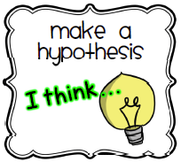
3. Act Like A Scientist

Slide 11
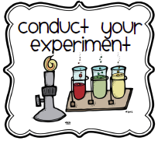
3. Act Like A Scientist

Slide 12
3. Act Like A Scientist

Slide 13
3. Act Like A Scientist

Slide 14
3. Act Like A Scientist

Slide 15
3. Example - Observation
* Story courtesy of National Lightning Safety Institute

Slide 16
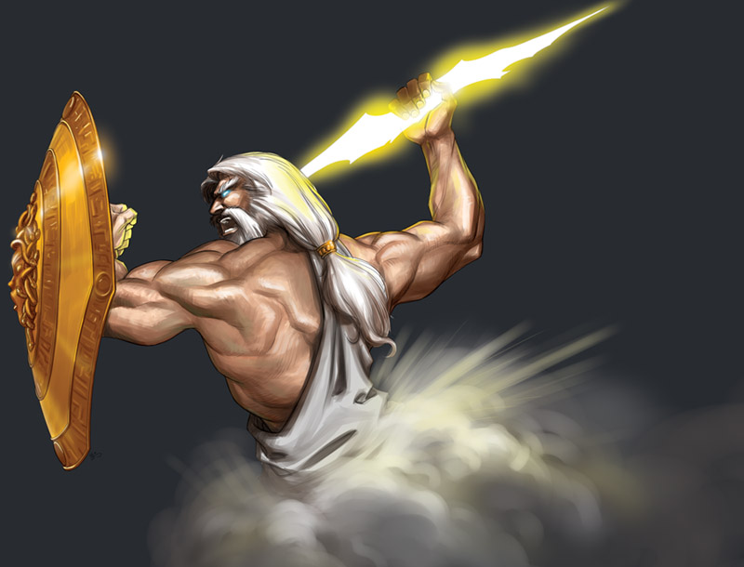
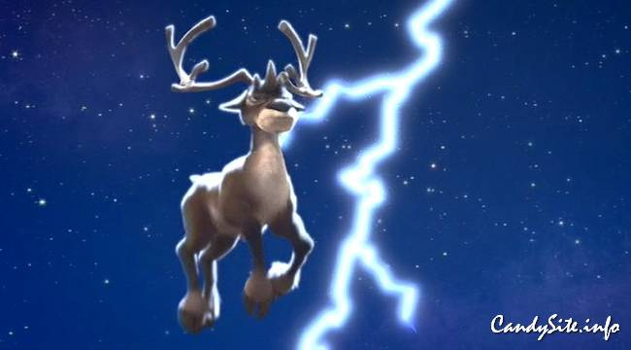
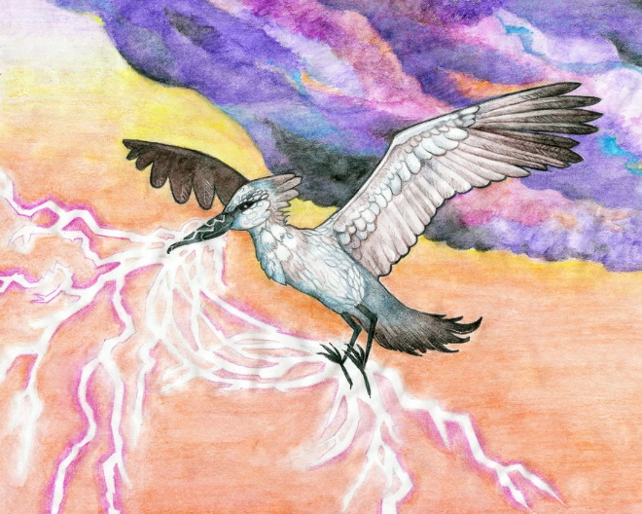
3. Example - Hypothesis
* Story courtesy of National Lightning Safety Institute

Slide 17
3. Example - Observation Leyden Jar
* Story courtesy of National Lightning Safety Institute

Slide 18
3. Example - Question
* Story courtesy of National Lightning Safety Institute

Slide 19
3. Example - Hypothesis
* Story courtesy of National Lightning Safety Institute

Slide 20
3. Example - Experiment
* Story courtesy of National Lightning Safety Institute

Slide 21
3. Example - Conclusions
* Story courtesy of National Lightning Safety Institute

Slide 22
3. Example - Report
* Story courtesy of National Lightning Safety Institute

Slide 23
3. Experiments
Most Effective Way to Clean a Penny
30 minutes
Need:
Water
Coke-a-cola
Vinegar
Soap
Penny
Containers
Task:
Fill container
with liquid
Insert Penny
Wait 30 minutes
Analyze
New Observations:
Change time
Change Liquid
Change object

Slide 24
3. Experiments
Brown an Egg
30 minutes
Need:
Water
Coke-a-cola
Egg
Containers
Task:
Fill container
with liquid
Insert Egg
Wait 30 minutes
Analyze
New Observations:
Change time
Change Liquid
Change object

Slide 25
3. Experiments
Low-Flow Volcano
10 minutes
Need:
Ketchup
Baking Soda
Volcano
Tub/Mat
Task:
Put ketchup in
volcano
Put Baking Soda
in volcano
Watch
New Observations:
Different liquid
Different Solid
Different amounts

Slide 26
3. Experiments
Medium-Flow Volcano
10 minutes
Need:
Vinegar
Baking Soda
Volcano
Tub/Mat
Task:
Put Vinegar in
volcano
Put Baking Soda
in volcano
Watch
New Observations:
Different liquid
Different Solid
Different amounts

Slide 27
3. Experiments
High-Flow Volcano
10 minutes
Need:
Diet Coke
Mentos
Volcano
Big Tub/Mat
Task:
Put Diet Coke in
volcano
Put Mentos
in volcano
Watch
New Observations:
Different liquid
Different Solid
Different amounts

Slide 28
3. Experiments
Clear Coke-a-cola
10 minutes
Need:
Coke-a-Cola
Milk
Container
Task:
Pour liquids in
container
Watch
New Observations:
Different liquid
Different Solid
Different amounts

Slide 29
3. Act Like A Scientist
Observe
Question
Hypothesis
Experiment
Analyze
Report

Slide 30
4. Visit Where Science is Done
Go to a place where any science is being done
Visit with someone who does science
Ask what they do, why they do it, and what attracted them to their jobs

Slide 31
4. Visit Where Science is Done
Places to Visit
Recycling Center
Zoo
Museum
Weather Station
Observatory
Hatchery
Farm
Aquarium
College
Nature Centers
Police Crime Lab
Power Plants
3m
Made Science MN

Slide 32
5. Discuss What you have Learned
Why do we want to study science
What are the components of the Scientific Method
Who are famous scientists
What types of work to scientists do
Where did you go to learn about science
What did you learn in this adventure

Slide 33
Thank you!

