Slide 1
Tech Talk
Cub Scout NOVA

Slide 2
Award Overview
Discover how Technology is used every day
Research for an hour
Earn 1 adventure for your rank
Explore Technology in our world
Visit where technology is used
Discuss what you have learned

Slide 3
1. Research for an Hour
Books:
Technology during World War 2
3d Printers
Making Robots
Super Cool Tech
Unusual and Awesome Jobs using Technology
TV Shows:
How Stuff Works
Mythbusters
Fight For Space
Star Trek
Movies:
October Sky
Appollo 13
Big Hero 6
Short Circuit
Youtube:
Code Kids: CBS Documentary
The Robots Technology
The World in 2050
The best gadgets of the 80s
Popular Mechanics for Kids

Slide 4
2. Group Activity – Rank Adventure
Wolf | Bear | Webelos / AOL
Finding Your Way | Make it Move | Build It
Motor Away | A World of Sound | Fix It
 |  | Movie Making

Slide 5
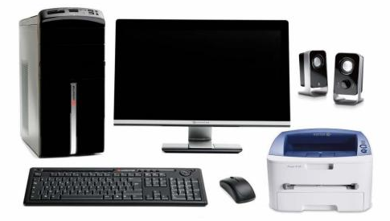
2. Group Activity – Computers
Find the following parts of a computer:
Central Processing Unit (CPU)
Monitor
Modem
Keyboard
Mouse
Printer
Many Devices use computer chips
Name 10
Organize data on a spreadsheet program

Slide 6
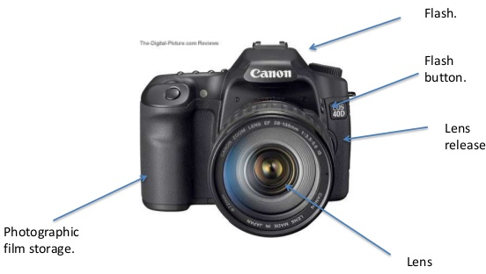
2. Group Activity – Cameras
Find the following parts of a camera:
Lens
Release
Flash
Film Storage
Capture button
How does photography benefit our world?
Take 10 pictures and share them
Capture Button

Slide 7
3. Explore Technology in our World
Define what Technology Is
How is Technology used?
Communication
Business
Construction
Sports
Entertainment

Slide 8
3a. What Is Technology?
Devices with computer chips in them
The application of scientific knowledge for practical purposes
The structured ability to learn about our world
Improvements in farming yield
The process that makes our cakes taste better

Slide 9
3b. How is Technology Used in: Communication

Slide 10
3b. How is Technology Used in: Communication

Slide 11
3b. How is Technology Used in: Business

Slide 12
3b. How is Technology Used in: Business

Slide 13
3b. How is Technology Used in: Business

Slide 14
3b. How is Technology Used in: Construction

Slide 15
3b. How is Technology Used in: Construction

Slide 16
3b. How is Technology Used in: Sports

Slide 17
3b. How is Technology Used in: Sports

Slide 18
3b. How is Technology Used in: Sports

Slide 19
3b. How is Technology Used in: Entertainment

Slide 20
3b. How is Technology Used in: Entertainment

Slide 21
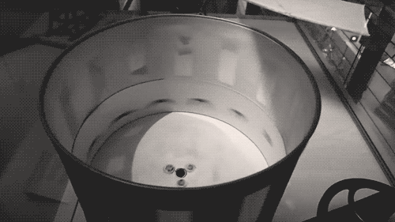
3b. How is Technology Used in: Entertainment

Slide 22
3b. How is Technology Used in: Entertainment

Slide 23
3b. How is Technology Used in: Entertainment

Slide 24
4. Visit Where Technology is Used
Factory
Store
Library
Farm
Construction Site
Recording Studio
Computer Repair Center
Gaming Arena/Stadium
Printing Shop
Transit Station / Airport
Nearly Everywhere!

Slide 25
4. Visit Where Technology is Used
Talk to someone working
Ask them how Technology improves their job
Ask why the organization uses this technology
Discuss with your counselor

Slide 26
5. Review
What is technology
How does technology impact your everyday lives?
How has technology changed over the years
Why do jobs use technology?

